Slide 1
Using Reinforcement Learning to Beat my Children (at board games)
Notes:
Bring cards along to the presentation
ANN vs NEAT don’t need to differentiate
Can’t know what’s in a digital twin
Move the so what earlier
Cut down jack and jill version on how can it be applied to other things.
Would be good to have "an ending" - not the lessons bits more did you do what you set out to do - did the ai win - can I see it etc etc great technically though - Jordans right maybe too much for beginners Thanks
BLUF.

Slide 2
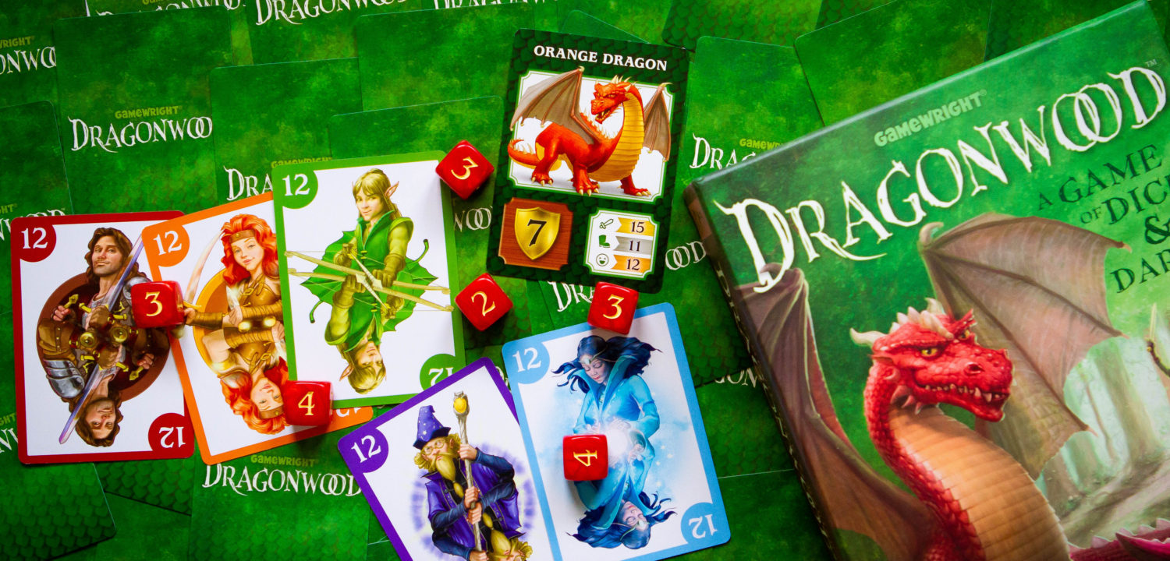
My Problem
My Kids enjoy playing the dice and card game Dragonwood and were increasingly getting better at it.
I decided to approach the problem like I would a work problem and see if I could use Data Science or Machine Learning to help understand the probabilities and maybe learn some strategies.
Notes:
Kids like playing dragon wood
Increasingly getting better at it
I needed some help and strategies to beat my children
So I turned to Machine Learning

Slide 3
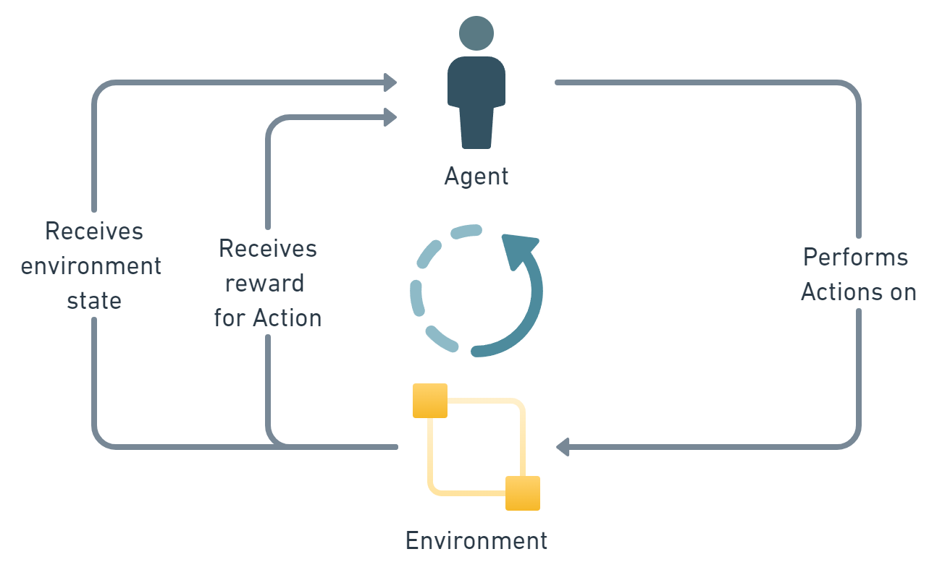
Reinforcement Learning
Reinforming Learning is a Paradigm within Machine Learning where an Agent operates within an environment to try and understand and learn the impact of it’s actions via a reward function.
This is well suited for games and works well for learning without having rules explicitly stated.
Notes:
Agent. An AI controlled user that can perform actions on the environment given a game state and receive a reward for those actions.
Environment. The environment is the entity we are a looking to learn from.
State. The state of the environment is a set of variables that describe the current game. This is something we have to devise and make sure it includes enough information for the AI to learn from.
Action. The action or decision that the AI has performed.
Reward. This is a function that provides a numerical measure on the suitability of the AI's action within the environment for the given state. This is for us to define and should reward the AI to prioritise beneficial behaviour. In our case we want to prioritise not only getting points but also winning the game.

Slide 4
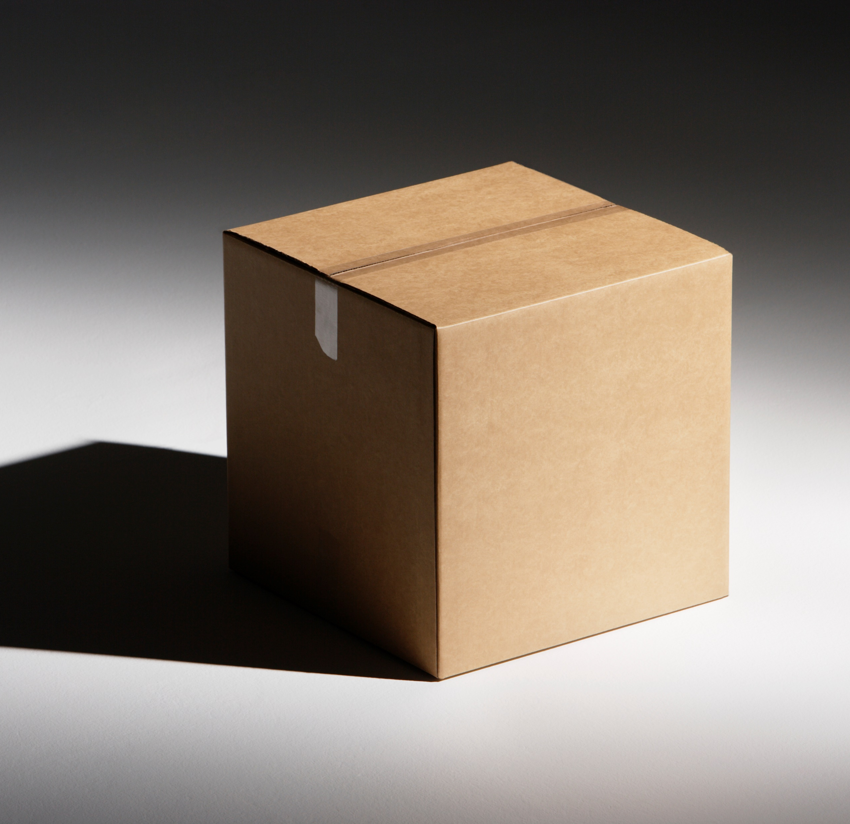
Reinforcement Learning
Works well under the following conditions
Where the underlying system is too complex to optimise deterministically:
Supply chains
Maintenance Schedules
Where the system is a black box:
Digital twins
Where there are limited resources:
Demand planning
Scheduling

Slide 5
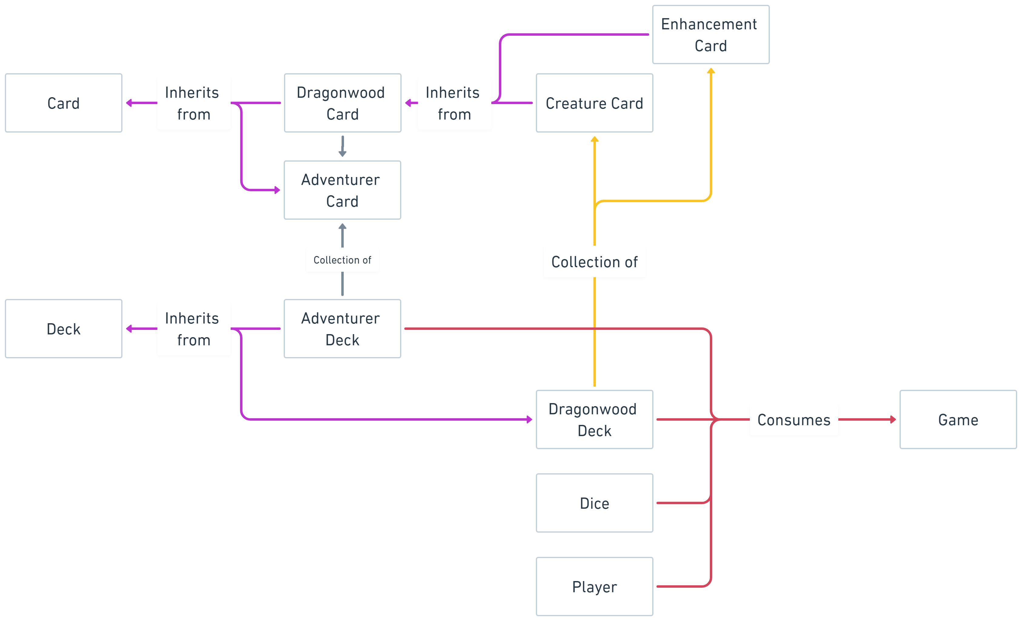
Python Model
First step was to programmatically model the game within Python.
I set up a series of classes and methods to allow me to play the game using a deterministic algorithm to make decisions.
This Reinforcement Leaning algorithm would then use this program and deterministic algorithm to compete against and eventually learn the games rules.

Slide 6
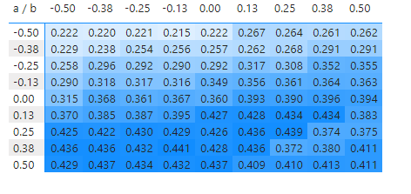
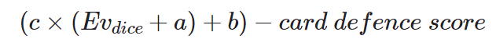
Deterministic Algorithm
As there were 3 other players in the game a way of them selecting moves was needed.
This involved optimising the formula to the right using a method called Grid Search to find best value for a and b.
Where:
𝑐 is the number of attacking cards
𝐸𝑣𝑑𝑖𝑐𝑒 is expected value of the dice.
𝑐𝑎𝑟𝑑 𝑑𝑒𝑓𝑒𝑛𝑐𝑒 𝑠𝑐𝑜𝑟𝑒 is the Dragonwood card's score to beat for that attack type.

Slide 7
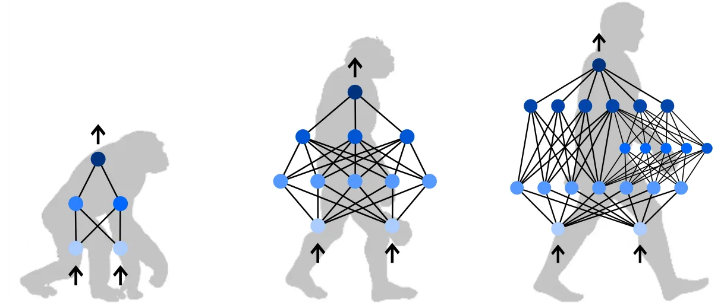
Develop an AI - Neuroevolution of Augmenting Topologies
The Reinforcement Learning Algorithm I used was NeuroEvolution of Augmenting Topologies (NEAT).
This is a genetic algorithm based on the principals of evolution and natural selection. A neural network is varied over time using reproduction and mutation to find the best performing architecture against a reward function.
Notes:
“Evolutionary” Algorithm used to generate Artificial Neural Networks to solve problems
Varies weights, biases and structure of Neural Network to find best solution.
Neural Networks undergo reproduction, can mutate and have their Species and Genes tracked throughout the process
Develops structure over time from simple beginnings
Similar performance to “Gradient Descent” used in some Neural Networks but does not need labelled dataset
Fit’s well for our problem. People have used it to teach AI to play Monopoly

Slide 8
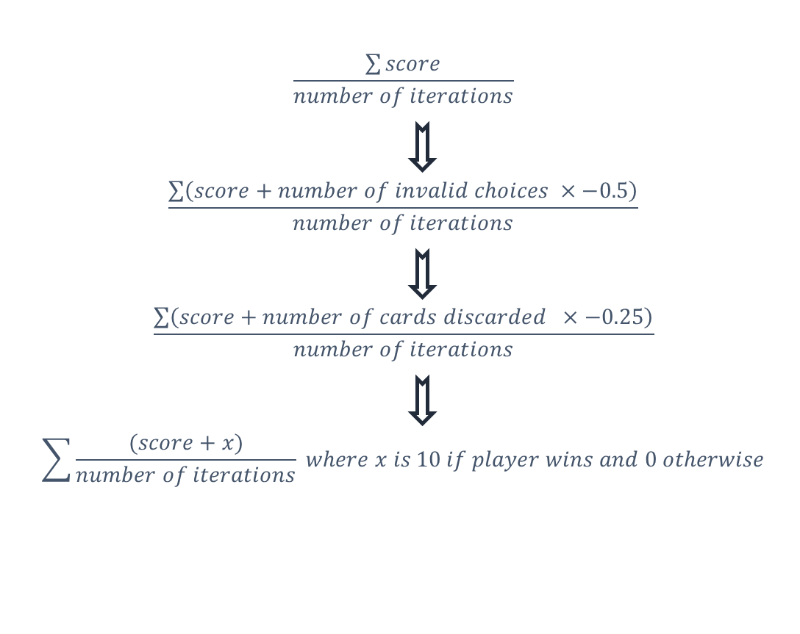
Fitness Function
I had to define a function to tell the algorithm which behaviours were correct and to hopefully maximise the score and beat our deterministic algorithm.
Initially the AI was performing lots of invalid moves and discarding cards needlessly, so I tried to change the fitness function to try and penalise it for these actions.
This was unsuccessful and so I completely stopped the AI for being able to perform invalid moves and this improved the results greatly.
Notes:
Like our deterministic algorithm we are trying to optimise:
The most points for the least amount of cards.
First did too many invalid choices
Second discarded too may cards
Third did nothing
Eventually we

Slide 9
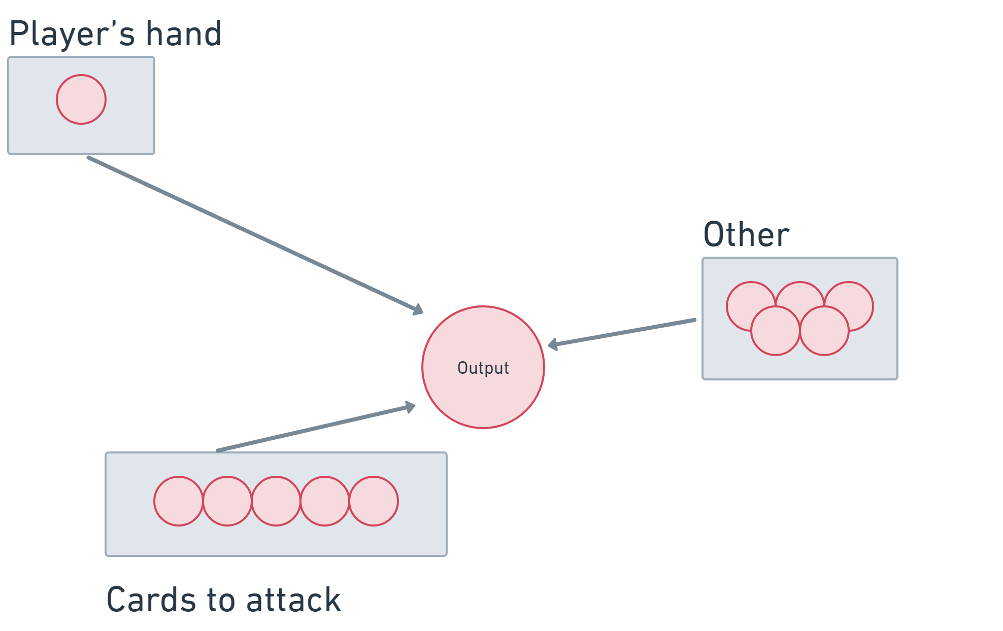
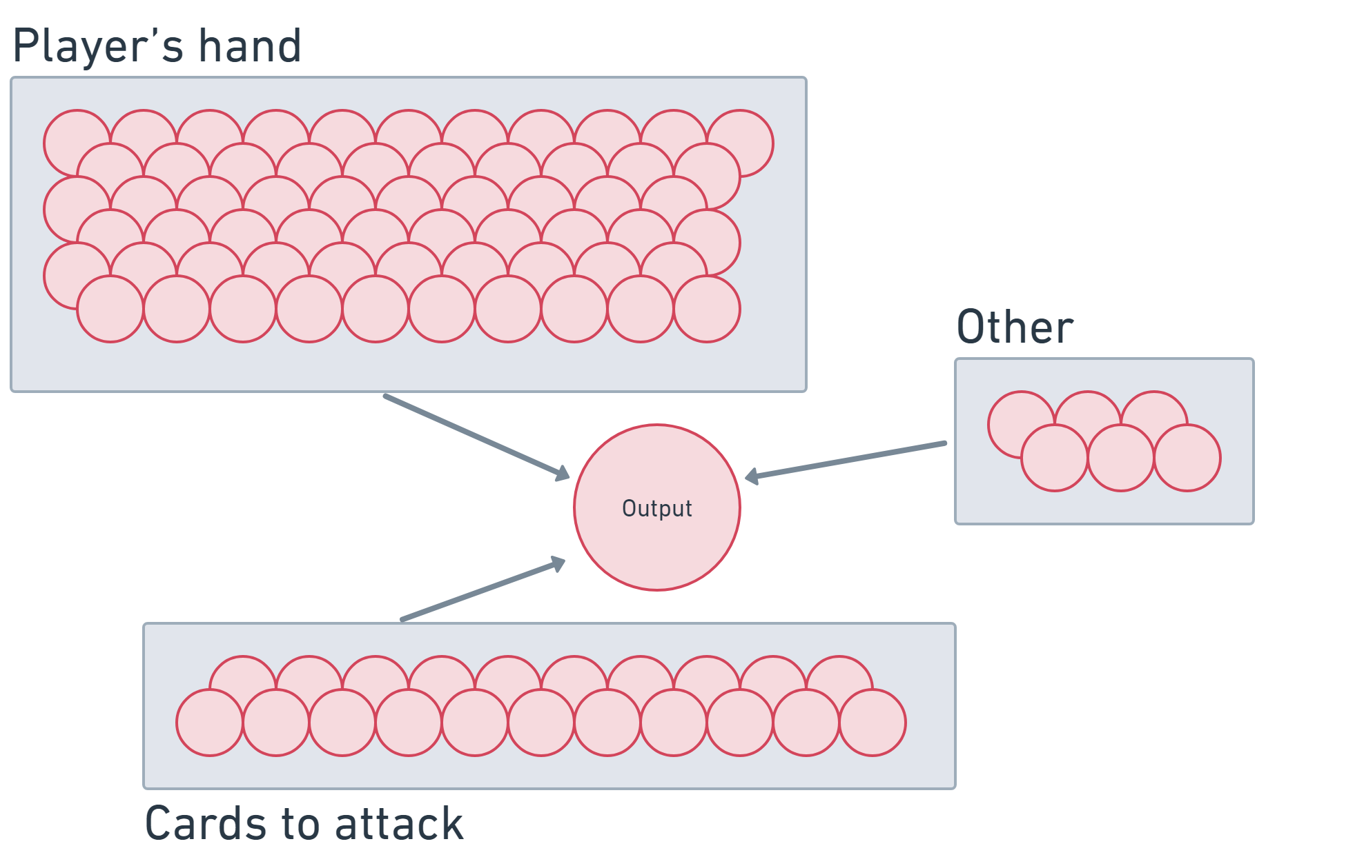
Input Encoding
Second iteration – 11 Neurons
First Iteration – 11 Neurons
Communicating how the game is going to the AI is very important and is done through the Input encoding.
My initial encoding was very complicated and resulted in poor results and little learning. After simplifying what I tell the AI the results improved greatly.
Notes:
Complexity of the input encoding

Slide 10
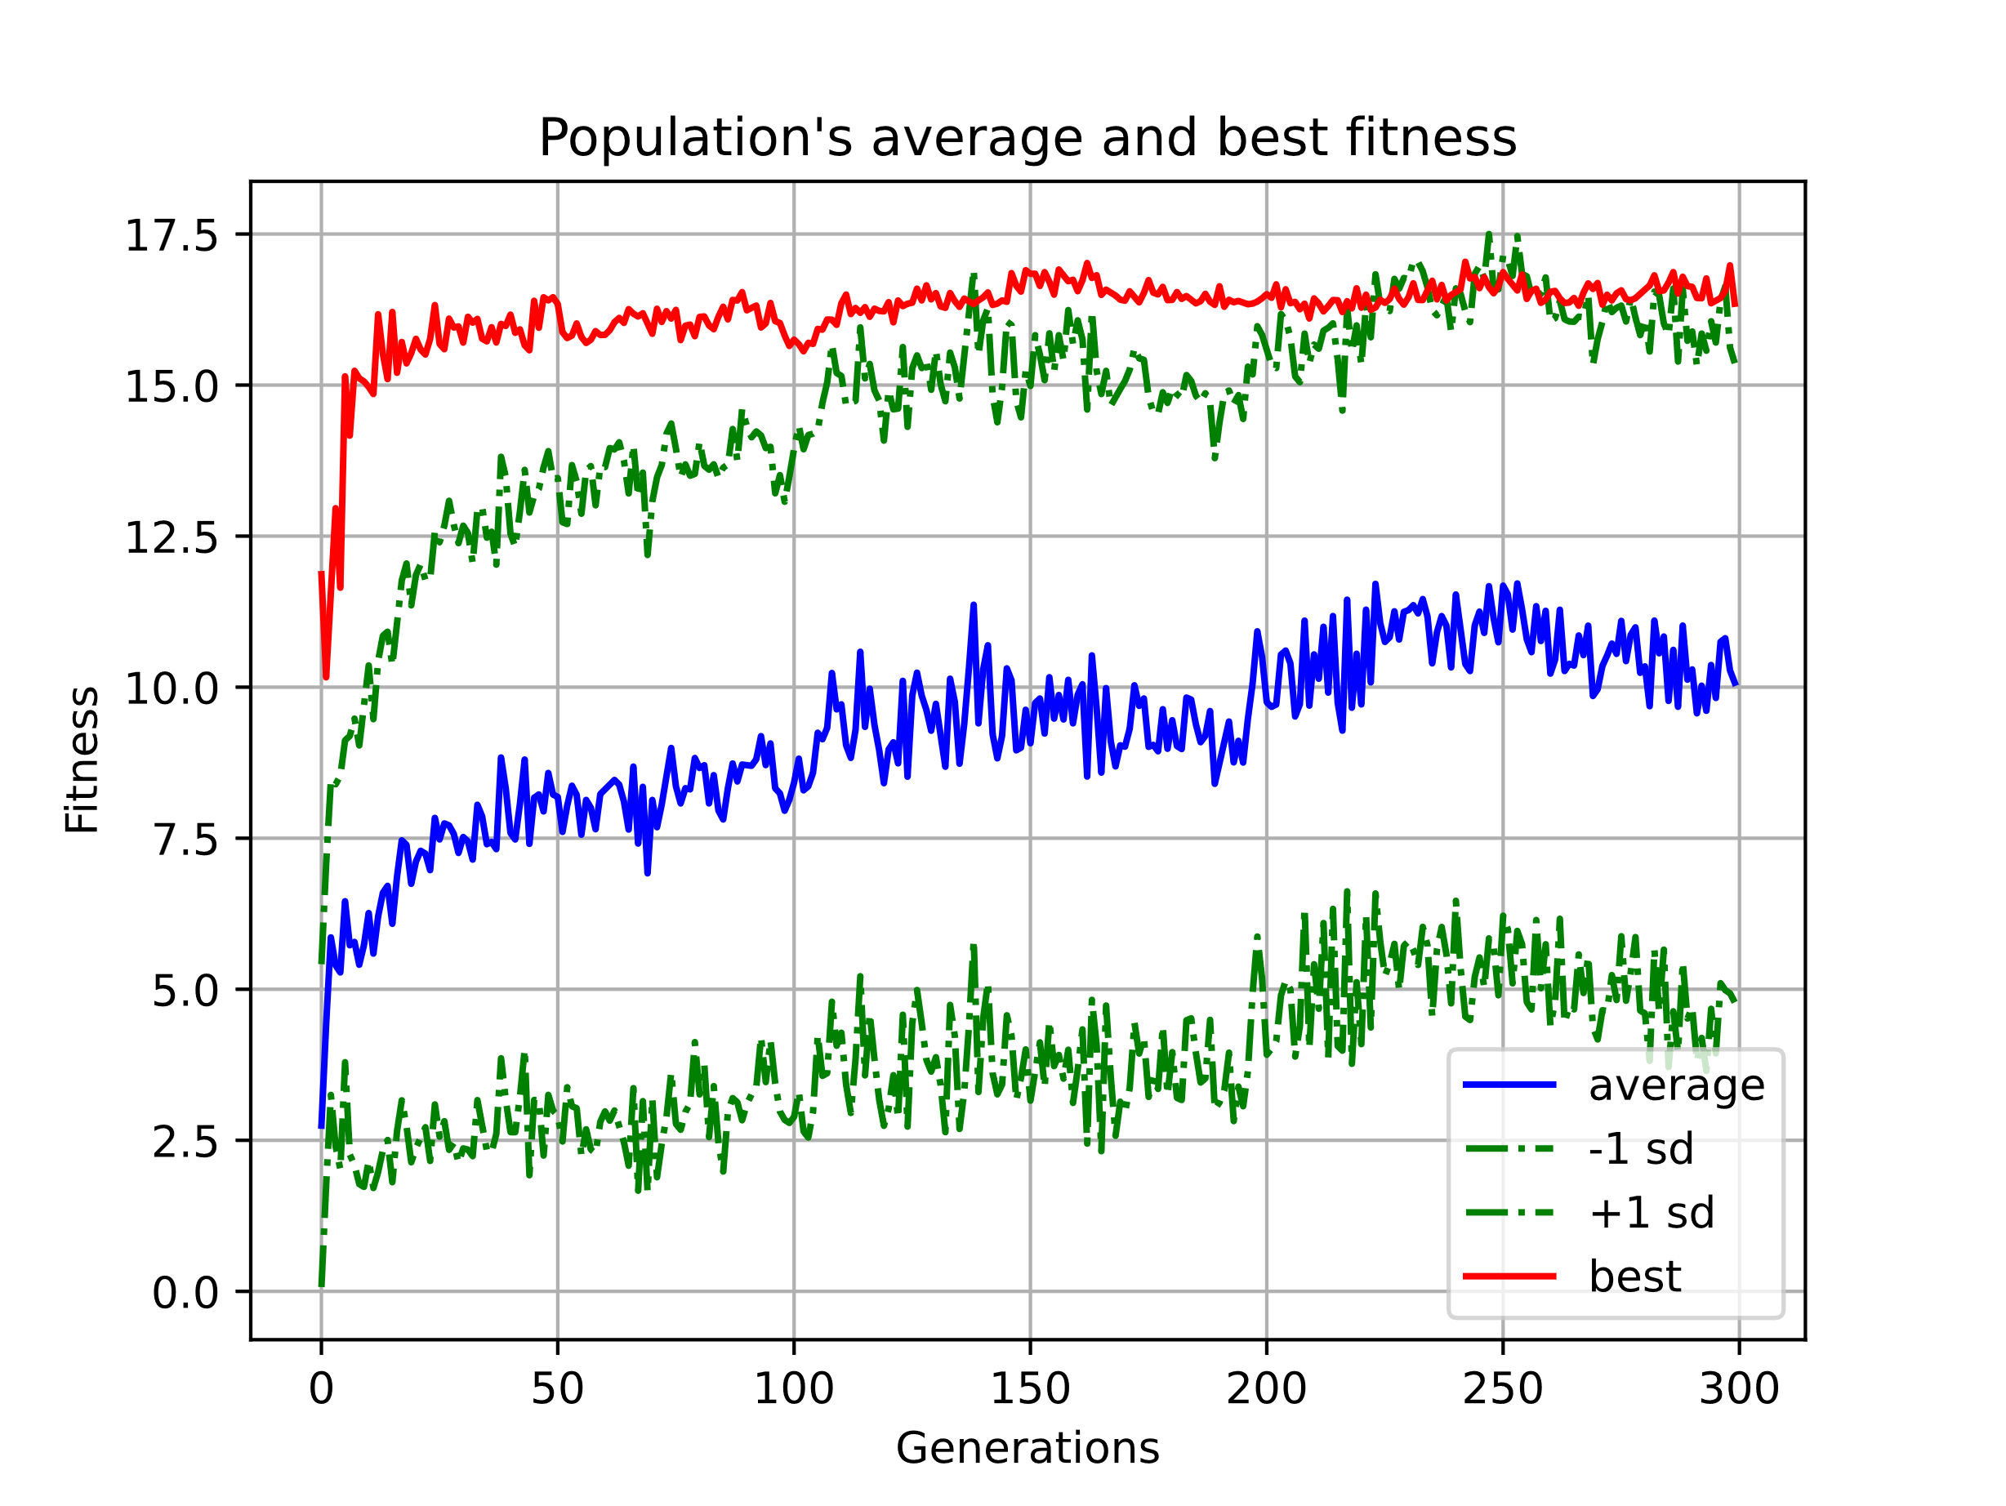
SUCCESS
After running the NEAT process for multiple generations and modelling over 90,000,000 games of Dragonwood, the AI started to be able to beat the deterministic algorithm that I devised.
Once training had been complete the AI could beat the other players 7% better than chance alone. While not an astounding result this is due to the large amount of luck inherent in the game and so is a large improvement.
The chart on the right shows how the AI improved it’s score over the training process.
Notes:
Over time we can see the average score obtained by the algorithm increase until we stopped it at 30 generations.
300 generations with 150 members with 2000 games over generation = 90,000,000 games played.

Slide 11
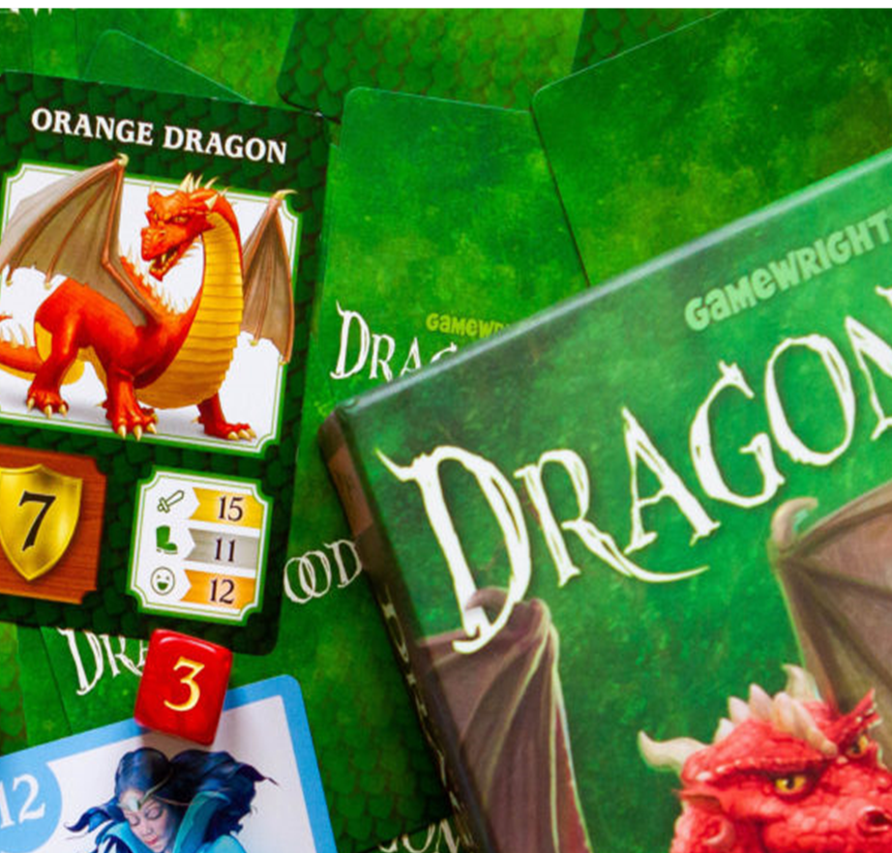
Lessons Learnt
Unfortunately, my kids had become bored of the game by the time I had completed my project and so I didn’t get to implement any of the strategies that I had learned from the process.
I did learn how to implement Reinforcement Learning and NEAT in a system and get an AI to learn the best action to take in a probabilistic environment.
I also learnt how important it is to chose a fitness function and input encoding and to only change one at a time.
Reinforcement Learning is a powerful technique with wide applications in defense and in business. It can be applied to areas as wide reaching as network security, autonomous vehicles and Large Language models.

